Slide 1
Astro-nots
Lab #8
KestrelSAT Capstone
Final Presentation
Notes:
Intro the team and the one-line goal: point KestrelSAT's solar array (-X face) at a light using the sun sensor, the gyro and the reaction wheel.
Old note kept from the PDR deck: https://www.youtube.com/watch?v=jVXgWGK9Kr8

Slide 2
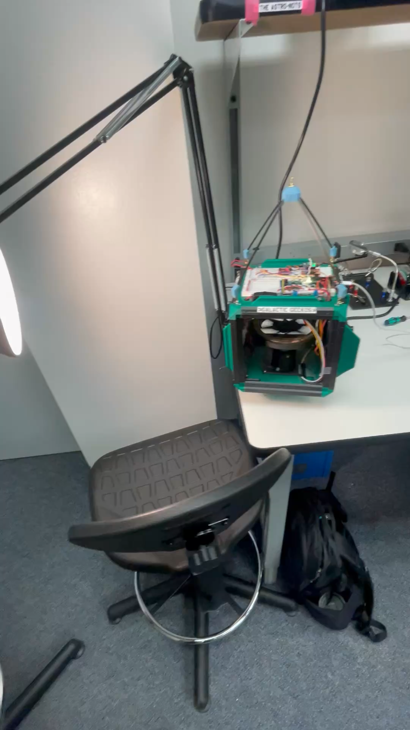
Overview
Why this matters
Requirements and final status
System design and code
What changed since the PDR
Results: pointing, simulation vs hardware, disturbance
Limitations and lessons learned
Live demo
Notes:
Roadmap. Clip on the right is the test stand.

Slide 3
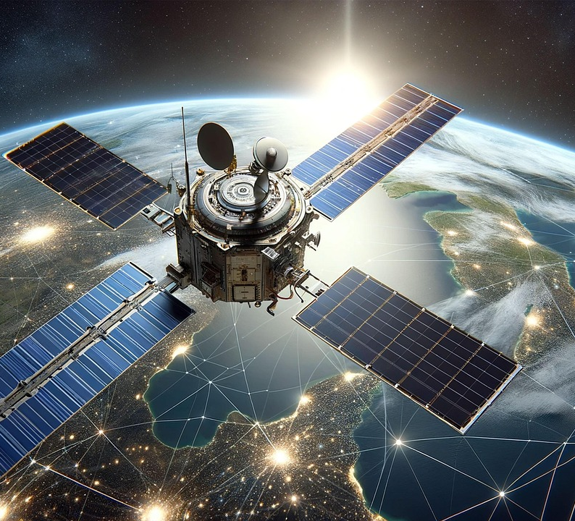
Application – Why does it matter?
Maximize Power Generation
  Keeping the solar array normal within 10° is essential to maintain a positive power budget and powering the satellite to complete its mission
Demonstrate an Effective Attitude Determination and Control System
  Essential for success of many different missions such as imaging, antenna pointing, etc.
Extending Mission Life
  Desaturating reaction wheels via mechanical means preserves fuel and extends the mission life of the spacecraft

Slide 4
Requirements
Requirement | Verification Method | Status at Final
While in sunlight, the KestrelSAT shall keep the solar array normal within 10° of the Sun vector. | During testing, mount KestrelSAT and measure the distance between the solar array normal and the Sun vector. Monitor the distance to ensure that they are within 10° of each other. | MET. Runs 014/015: 100% within ±10° after settling, RMS 2.4–2.6°, held ~95 s.
From an initial error of 180° away from the Sun vector, the KestrelSAT's solar array normal vector shall reach the Sun vector within 10 seconds, while maintaining the pointing accuracy requirement. | During testing, when there is an initial error of 180°, ensure KestrelSAT reaches the Sun vector within 10 seconds while maintaining the pointing accuracy requirement of 10°. | PARTIAL. From release: 14.5–15.7 s incl. the 10 s scan. Slew-only test is command 10 → 2. [TEAM: run it, add time]
The KestrelSAT shall maintain the pointing accuracy requirement while subject to external torques up to 2 Nm. | During testing, mount KestrelSAT and apply a 2 Nm disturbance torque using fans. Monitor the pointing accuracy to ensure that it is within the 10° pointing requirement. | MET until the wheel saturates: 2.0–2.8 mN·m held within ±10° for 52–55 s. [TEAM: '2 Nm' should be 2 mN·m?]
Stretch: While in Sun pointing mode, the KestrelSAT shall have a net positive battery charge rate. | Command KestrelSAT into Sun pointing mode and monitor the power system to ensure a net postitive battery charge rate. | [TEAM: run command 2 during command 4, or say why it was dropped]
Stretch: The KestrelSAT should desaturate its reaction wheels while maintain the pointing accuracy requirement. | During testing, KestrelSAT successfully desaturates its reaction wheel. Monitor the pointing accuracy to ensure that it is within the 10° pointing requirement. | Not attempted (no desaturation actuator). Wheel saturates ~50 s into the fan test.
Notes:
Spend time here. For each requirement: what we promised, how we verified it, and the evidence slide.
R1 evidence: Results slide (run_summary.csv). R2: Results slide + PDR-vs-final plot. R3: Disturbance slides.
Numbers use the gyro error (heading minus the sun heading the scan found). The sun-sensor error reads ~0 whenever only -X sees the light, so it can't show true accuracy.
TEAM DECISIONS: (1) README lists different requirements (R1 <=90 deg within 15 s, R2 hold 60 s, R3 logging 20 Hz / 2 Hz XBee, S1 moving light). Pick one set for the deck and repo. (2) Fix '2 Nm' units. (3) Battery stretch: test or drop.

Slide 5
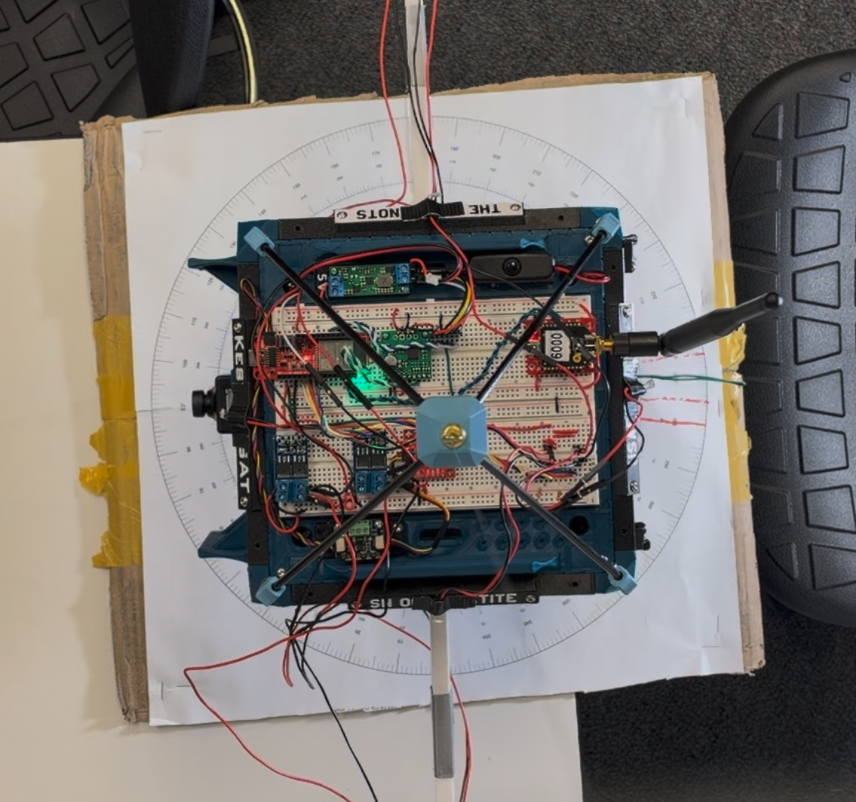
System Overview
Sensors
Lab 6 sun sensor: 4 phototransistors (±X, ±Y), 3.3 kΩ resistors
ICM-20948 gyro: body rate about Z, integrated to a heading
Actuator
Lab 7 reaction wheel, TB9051FTG driver, encoder; ±400 RPM on 5 V
Disturbance
4 × LD3007MS fans in diagonal pairs (CW / CCW), switched by XY-MOS
Avionics and ground
SparkFun Thing Plus ESP32, SD logging at 20 Hz, XBee telemetry to the GCS
Hung from a string over a degree ring; solar array = −X face (180°)
Notes:
Walk the hardware top-down. Point out the -X face (solar array) and the fan pairs.

Slide 6
Control Architecture
Sun sensor
4 faces, 16 reads / sample
360° scan
brightest −X = sun heading
Sequential lobing
aim ±3°, nudge to brighter
Gyro (Z)
rate → heading
Error
wrap(sun hdg + lobe − heading)
PD controller
τ = Kp·e − Kd·ω
Reaction wheel
ω̇w = −τ / Iw → RPM → PWM
Command 4 mode sequence (LED color)
SPIN-UP
yellow: hold still,
gyro bias measured
RELEASE
blue: let go
ACQUIRE
purple: 420° scan
at 45°/s (~9 s)
TRACK
orange → green:
PD + lobing
RESCAN / STOP
−X < 30% of peak → rescan;
no sun → wheel off
Notes:
The sun sensor only finds WHERE the sun is (during the scan, and by lobing). The gyro holds the heading. Why: near the target only -X sees the light, so the sun-sensor angle reads 180 deg anywhere in a ~30 deg cone (30 Oct run 011 rested 20 deg off). Gains Kp = 0.126, Kd = 0.1092 (definitions.h).

Slide 7
Code Walkthrough: PD Step (sun_tracker.cpp)
float tracker_step(float error_deg, float body_rate_dps, float dt_s, ...) {
float error_rad = error_deg / DEG_PER_RAD;
float rate_rad_s = body_rate_dps / DEG_PER_RAD;
if (fabsf(error_deg) < gains.deadband_deg) error_rad = 0.0f; // 1° deadband
// PD written as "turn at a desired rate", capped for smooth slews
float rate_des = (gains.Kp / gains.Kd) * error_rad;
rate_des = clamp(rate_des, -max_rate, max_rate);
float tau = gains.Kd * (rate_des - rate_rad_s);
// reaction torque: body feels -I_wheel * wheel accel
wheel_from_torque(tau, dt_s, limits, I_wheel, w_cmd_rpm, saturated);
return tau;
}
Hardware-free math
Same functions in sun_tracker_sim.py, so the sim tests the real logic
Settings in one file
definitions.h: gains, limits, scan, lobe, latch
Ground commands 0–8
4 = tracker, 6 = AD check, 7 = resistor sweep, 8 = fan hold
Safety
Every test ends on 'X' and stops the wheel
Notes:
Instructor asked us to show code and discuss it. Explain: error -> desired turn rate -> torque -> wheel speed. Mention the direction latch (latch_far_error) for 180 deg starts and the lobing (lobe_step). Have VS Code open as backup to show the repo.

Slide 8
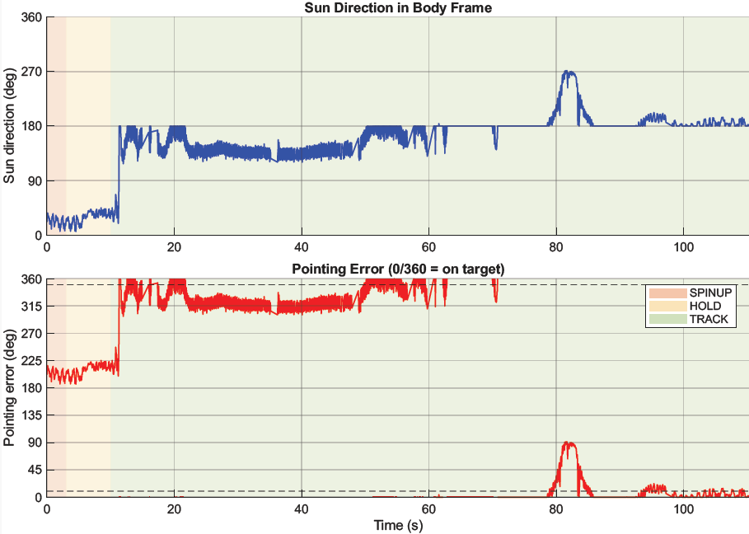
PDR Baseline: Run 052 (23 Oct)
Test 52: Most recent, 20kΩ
0-10s: S/C is initializing
10s: Sun is detected 15 ° (opposite solar array)
10-20s: S/C slews to face Sun
20s: React wheel saturates, unable to hold S/C on point
20-50s: Reaction wheel struggles to hold S/C on target, repeatedly saturating.
50-end of test: Data shows S/C as unusually accurate. Specific cause isn’t known. We suspect an intermittent loss of valid readings. Could be from sensor issues, software issues, or both.
Notes:
Short recap of where we were at the PDR. Don't dwell: 1 minute.

Slide 9
What Changed Since the PDR
Sensor saturation
Indecision at 180°
Problem: PDR: 10k/20k Ω resistors pinned faces at 4095.
Problem: Run 008: error sign flipped ~10×/s, wheel reversed.
Fix: Resistor sweep (cmd 7) → 3.3 kΩ: all 4 faces in the ADC's accurate range.
Fix: Direction latch: commit to one turn above 150°, release below 120°.
Blind cone near target
Gyro drift + lamp flicker
Problem: Only −X lit: angle read 181° anywhere; run 011 rested 20° off.
Problem: Run 014 drifted 20–30° in 100 s; 120 Hz flicker = ±300 counts.
Fix: 360° scan finds the sun heading; the gyro holds it.
Fix: Sequential lobing (±3°) + 16 reads spread over one flicker period.
Notes:
Each fix came from a specific run (all in 4. DATA/2. After PDR/2026-10-30 and AI_LOG.md). This answers the PDR feedback on the slew/pointing bias.

Slide 10
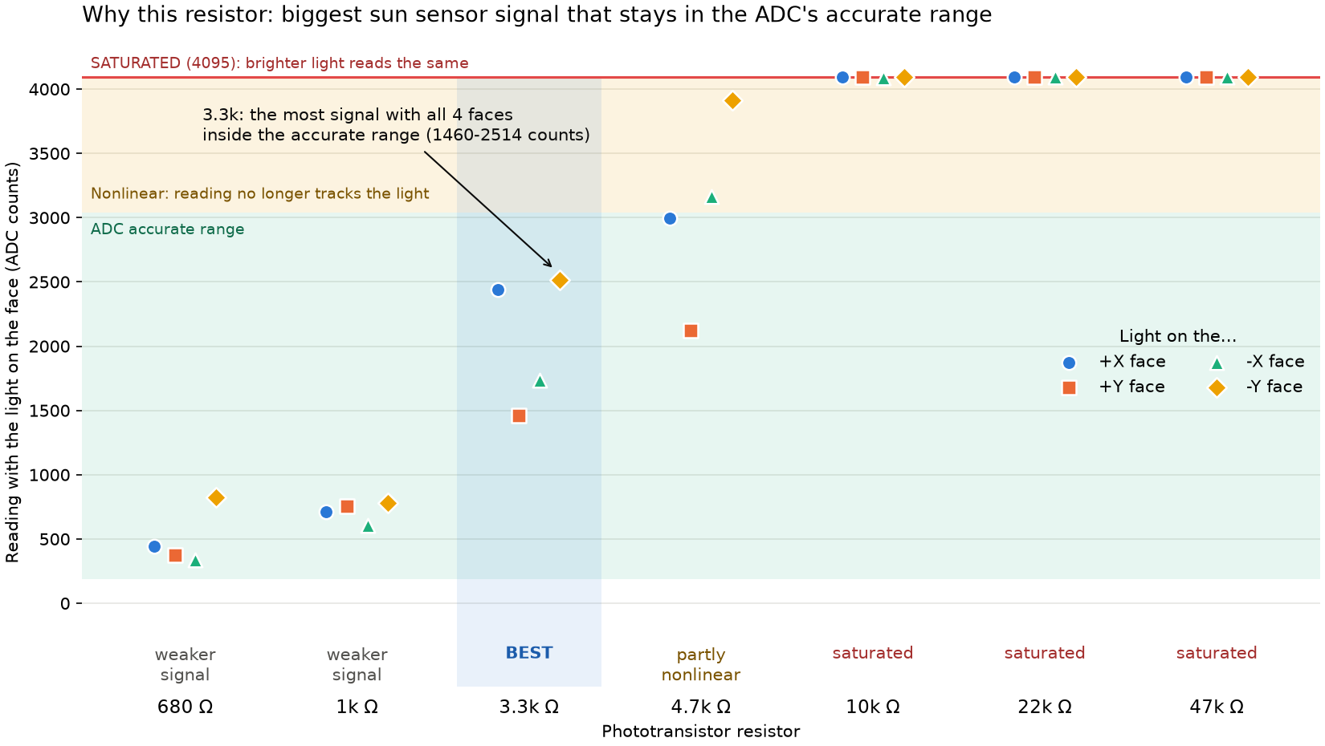
Fixing Sensor Saturation: Resistor Sweep
PDR: faces saturated at 4095 counts with 10k / 20k Ω
Test: command 7, light off + on each face, 680 Ω – 47 kΩ, same lamp distance
Result: 3.3 kΩ gives the most signal with all 4 faces in range (1460–2514 counts)
Then: recalibrated (cmd 3), checked with cmd 6
Notes:
PDR feedback: 'saturation -> resistor values -> show/compare data'. This is that chain. Data: 30 Oct PTSweep_data001.csv, plot_ptsweep.py.

Slide 11
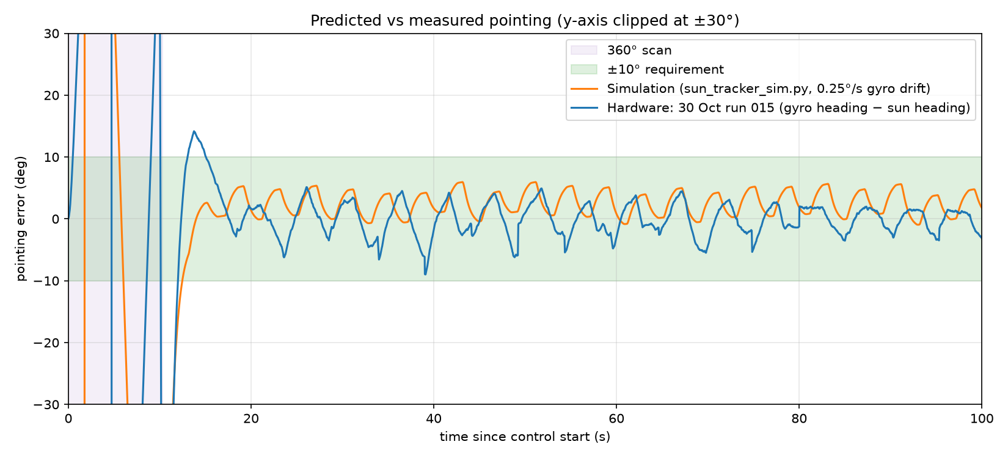
Simulation vs Hardware
12.5 s
sim settle time (same start)
15.1 s
hardware settle time, run 015
Agreement: both hold within about ±6° and show the same lobing ripple (~8 s period).
Difference: hardware overshoots to 14° after the scan; sim MOIs and the 1.1 s motor lag are estimates, and the sim has no string twist here.
Notes:
Rubric asks for predicted vs measured. Sim = sun_tracker_sim.py 'drift' setup with run 015's start error (105 deg). Made by 2. THEORY/final_figures.py.

Slide 12
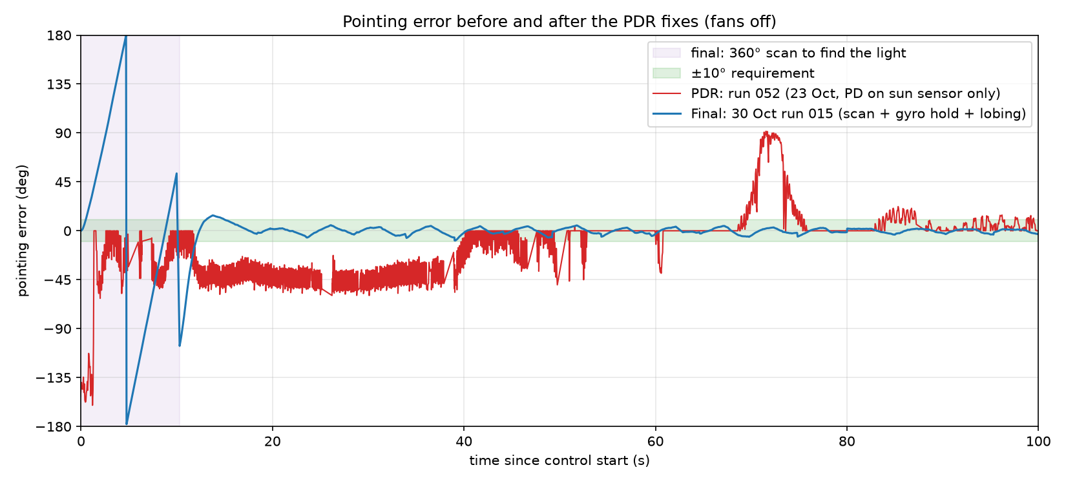
Pointing Error: PDR vs Final
~40°
PDR run 052: steady offset for ~30 s, 90° excursion
2.6°
final run 015: RMS error after settling
Caution: PDR run uses the sun-sensor error, final run the gyro error. The sun-sensor error reads ~0 when only −X is lit, so the PDR trace looks better than it was after 60 s.
Notes:
Instructor: 'useful pointing error plots, keep for final and compare'. This is that comparison. Purple = the 360 deg scan (error sweeps through +-180 by design).

Slide 13
Results: Fans-Off Tracking Runs
Run | Settle (s) | Longest in ±10° (s) | Within ±10° | Within ±5° | RMS error
30 Oct run 014 | 14.5 | 96 of 100 | 100% | 98% | 2.4°
30 Oct run 015 | 15.1 | 95 of 100 | 100% | 95% | 2.6°
2 Nov run 016 | 15.7 | 54 of 100 | 95% | 88% | 12.1°
2 Nov run 017 | 15.2 | 52 of 94 | 95% | 91% | 10.4°
14.5–15.7 s
95–100%
≈ 95 s
settle time (10 s is the scan)
of samples within ±10° after settling
longest continuous hold (runs 014/015)
Runs 016/017 held 52–54 s, then a rescan (−X dropped below 30% of peak) briefly took them out of the band. Error = gyro heading − scanned sun heading.
Notes:
PDR feedback: quantify settling time, error, wheel saturation. Wheel saturation was 0-1% of tracking time in these runs. Numbers from 6. FINAL/figures/run_summary.csv (final_figures.py).

Slide 14
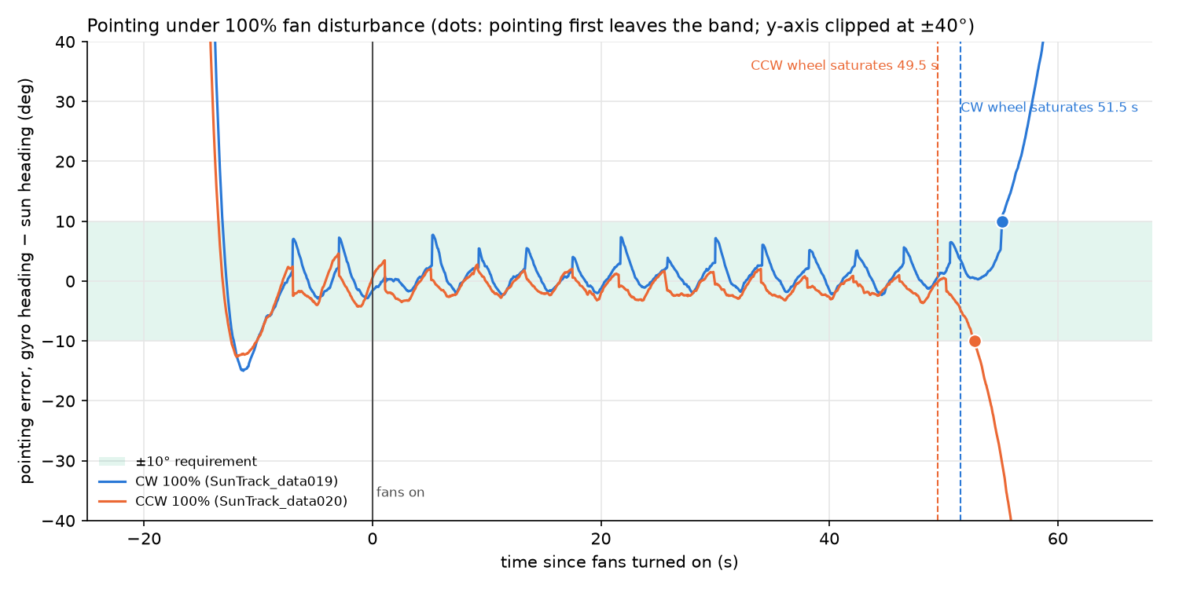
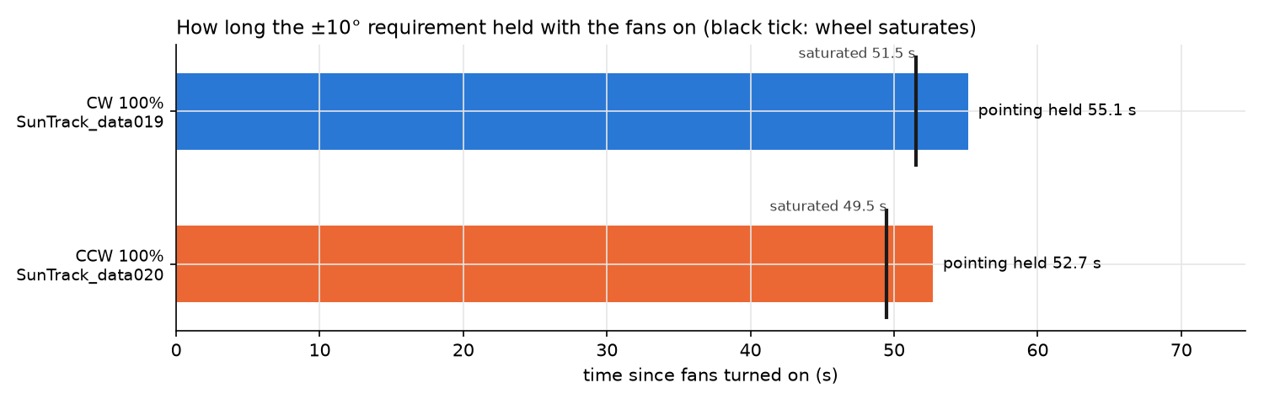
Disturbance Test: Pointing Under Fan Torque
52–55 s
pointing held with 100% fans
≤ 7.7°
worst error before the wheel saturated
Pointing is lost ~3 s after the wheel hits ±400 RPM: the wheel, not the controller, sets the limit.
Notes:
2 Nov runs 019 (CW) and 020 (CCW), command 8. Fans turn on after 10 s inside +-10 deg. The fans started with the wheel near 0 RPM, so only half of the wheel's range was used.

Slide 15
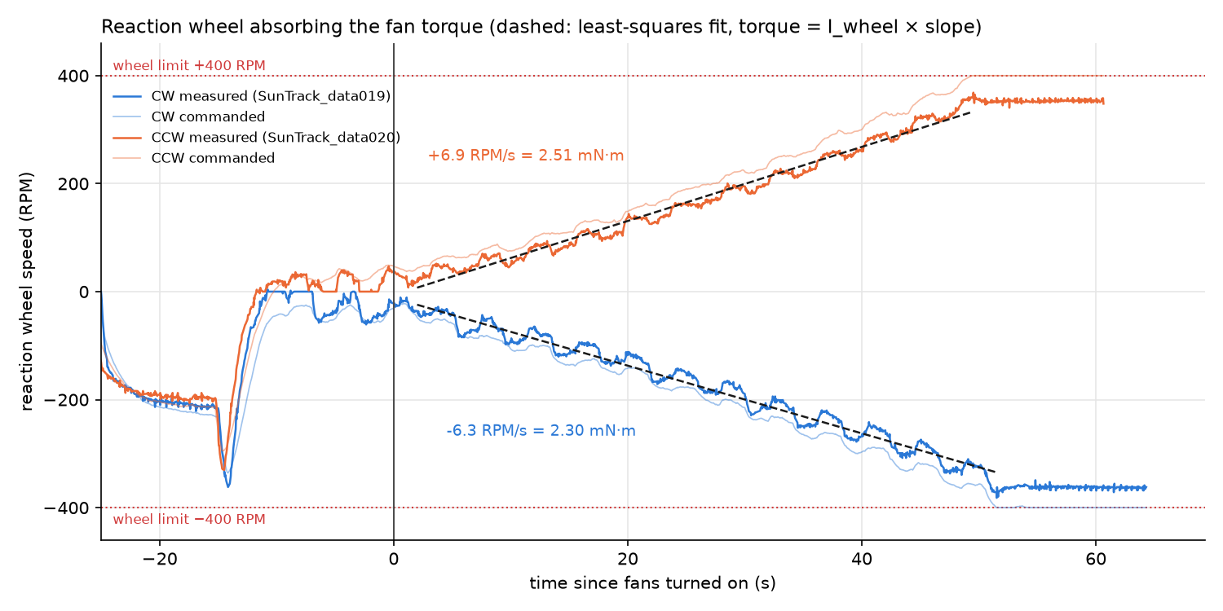
Measuring the Disturbance Torque
2.41 mN·m
measured per fan pair (mean)
2.51 mN·m
ducted-fan model prediction
Method: on target, all external torque goes into the wheel: τ = I_wheel × slope of wheel speed.
Uncertainty: 2.0–2.8 mN·m depending on the background (string, air) estimate; one run per direction.
Notes:
fan_thrust_model.py --csv with --baseline 016 017 018. Fans-off background -0.20 to -0.34 mN·m. More runs per direction would narrow the range.

Slide 16
Limitations and Uncertainty
Accuracy depends on the scan
Moving light (5°/s) fails
Gyro error is only as good as the sun heading the scan found; true error needs video.
PD lags ~14° and each move triggers a rescan; needs error-rate damping or an integral term.
Shared 5 V rail
Model parameters estimated
Fans and wheel sag the rail; the old fan sweep was unusable for this reason.
I_body, I_wheel from the prelab; motor lag 1.1 s from one spin-up.
Few repeats
String torsion
One fan run per direction; two days of tracking runs.
Adds a spring torque (~13° offset in sim) that lobing has to fight.
Notes:
Rubric: uncertainty and implications for next steps. Be upfront: this is what a reviewer will ask about.

Slide 17
Live Demo
Command 10: requirement demo
10 → 1: R1, PASS after 30 s inside ±10°
10 → 2: R2, turns 180° away, timed slew back (≤ 10 s)
10 → 3: R3, fans on after 10 s in band, PASS after 30 s
What to watch
LED: purple = scan, green = within ±10°
GCS: error and wheel speed live over XBee
Backup
[TEAM: video of a good run]
[TEAM: GCS screenshot or demo video]
Notes:
Extra credit for a successful live demo. Command 10 is new and NOT yet tested on hardware: rehearse it first. Charge the battery first, check XBee link, lamp at the marked distance. If the demo fails, switch to the backup video right away.

Slide 18
Lessons Learned and AI Use
Lessons learned
Test one subsystem at a time: commands 6 and 7 found wiring and resistor problems fast
Log everything: each fix came from a specific SD-card run
A sensor that reads well on the bench can lie in the loop (blind cone, flicker)
Simulate first: the latch, scan and lobing were tested in the sim before hardware
GenAI (Level 4)
Claude Code wrote firmware, sim and analysis scripts from our test findings
We ran every hardware test, checked signs, and decided each change
Every session is logged in AI_LOG.md in the repo
[TEAM: one example where you rejected or fixed AI output]
Notes:
Rubric: documented GenAI usage. Make the last bullet real (e.g. the wheel sign found from data, ±Y faces mislabeled).

Slide 19
Questions?
Repo: [TEAM: GitHub link]
Data: 4. DATA/ • Analysis: 2. THEORY/ • Firmware: 3. CODE/KestrelSAT_SunTracker/
Notes:
Email the repo link before the presentation day.

